Slide 1
Machine Learning

Slide 2
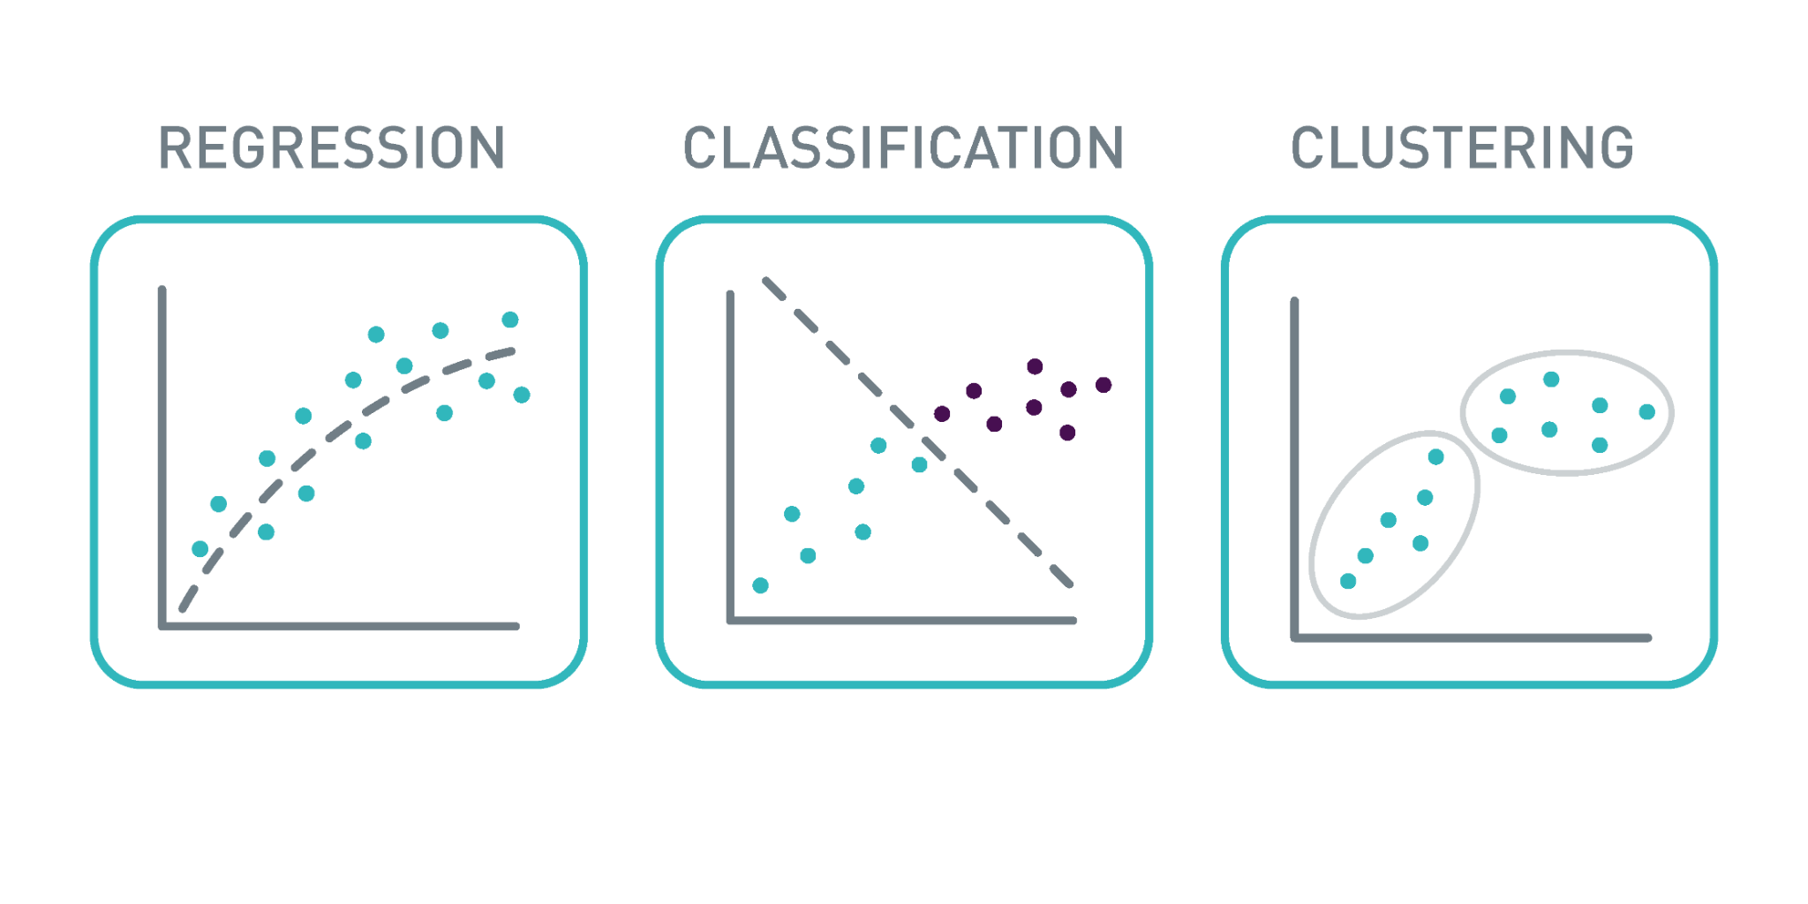
ML Tasks
1. Regression
Supervised Learning
Predict continuous value
e.g., relationship between age and height
2. Classification
Supervised Learning
Predict discrete class label
3. Clustering
Unsupervised Learning
Group data points with similar characteristics as clusters
https://www.ait.ac.at/en/research-topics/ai-machine-learning

Slide 3
Popular ML Algorithms
Algorithm | Type | Task
Linear Regression | Supervised Learning | Regression
Logistic Regression | Supervised Learning | Classification
K-Nearest Neighbors | Supervised Learning | Classification
KNN | Supervised Learning | Classification
SVM | Supervised Learning | Classification
K-means clustering | Unsupervised Learning | Clustering

Slide 4
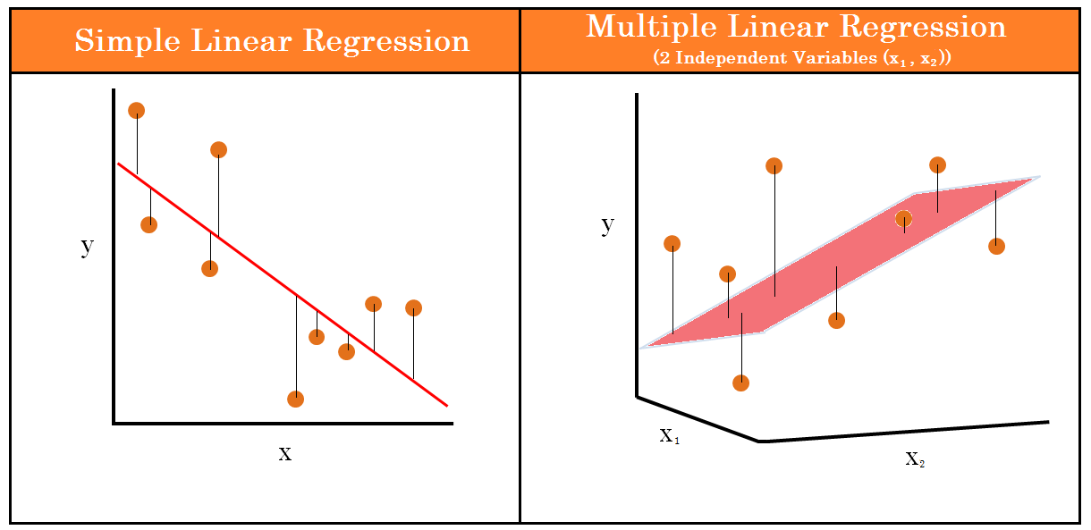
Linear Regression
1. Simple Linear Regression
one independent variable and one dependent variable
Obesity results in higher chance of getting diabetes
Relation between sleep quality and student’s academic performance
Impact of product price on number of sales
2. Multiple Linear Regression
multiple independent variables and one dependent variable
How weather factors like cloudiness, temperature and humidity effect a person’s mood
Connection between a person’s salary between his position, job tenure, and age
https://www.analyticsvidhya.com/blog/2021/11/startups-profit-prediction-using-multiple-linear-regression/

Slide 5
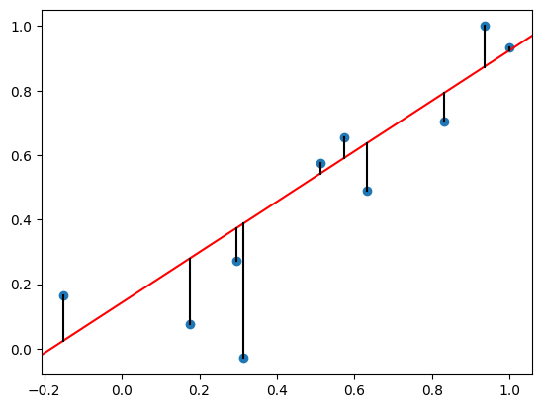
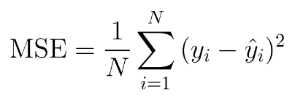
Linear Regression: Loss Function
To find a line or hyperplane with the smallest possible residuals, we need a loss
function to indicate whether the variables are being updated in the right direction.
Also known as cost, error function
Quantify the difference between predicted and actual values
Evaluate the model’s prediction accuracy
Mean Square Error (MSE): The average of the squared differences
between the prediction and true label.

Slide 6
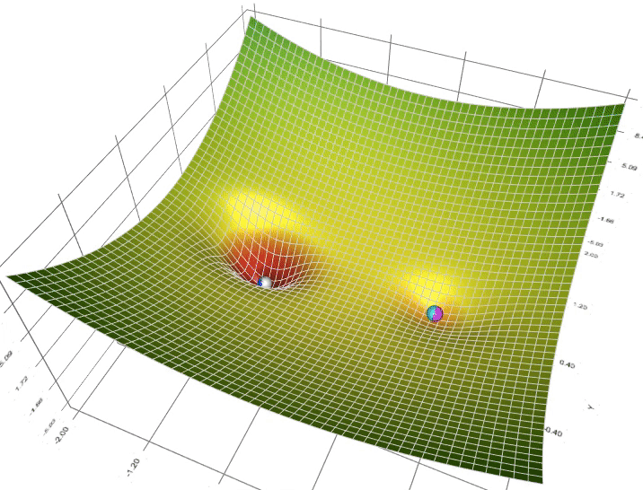
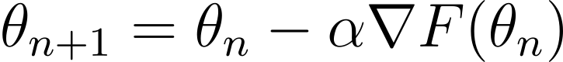
Gradient Descent
To optimize the outcome of loss function, we need an algorithm that can
update the variables automatically.
Assume the loss function is differentiable, the Gradient Descent algorithm is
performed by calculating the loss function’s derivative (slope) and update
the variables toward the local minimum iteratively.
The model’s learning rate determines how fast the variables are updated.
Its value could be fixed or updated adaptively during the training phase.
a: learning rate, F(theta): loss function
https://towardsdatascience.com/a-visual-explanation-of-gradient-descent-methods-momentum-adagrad-rmsprop-adam-f898b102325c

Slide 7
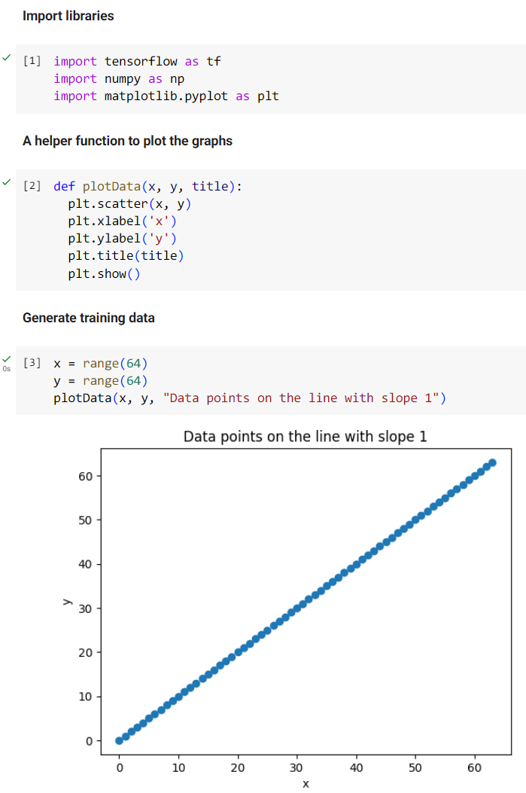
Linear Regression: Preparation
Numpy offers various mathematical functions for us, we can use them to
create and process data easily.
Using Pyplot from Matplotlib, we can visualize our data to gain a better
understanding of how the algorithms work.
We will use the following functions to display the data as dots:
plt.scatter(x, y): Plots a scatter plot using a list of x and y coordinates
plt.xlabel(“xlabel”): Set the label for x-axis
plt.ylabel(“ylabel”): Set the label for y-axis
plt.title(“title”): Set the title
plt.show(): Displays the figure

Slide 8
Linear Regression: Training Data
The first step in creating the training data is to use range(64)
to assign two lists of numbers from 0 to 63 to variable x and y.
The Variable x and y represents the x and y coordinates of
dots on the line y = x.
Now, passing variables x and y through the plotData() function
defined in the previous slide, this allows us to visualize the
data with x and y axes.

Slide 9
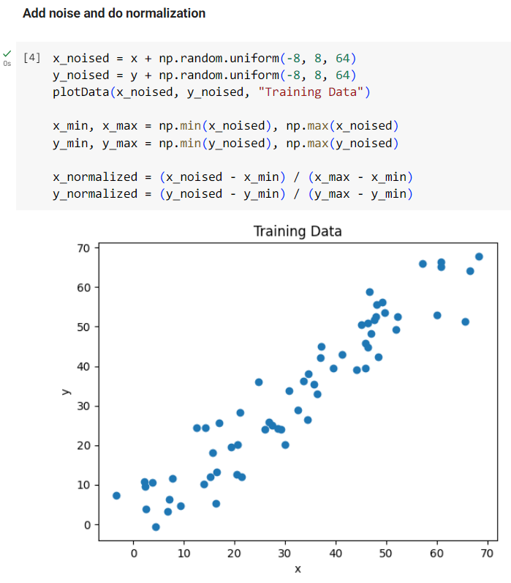
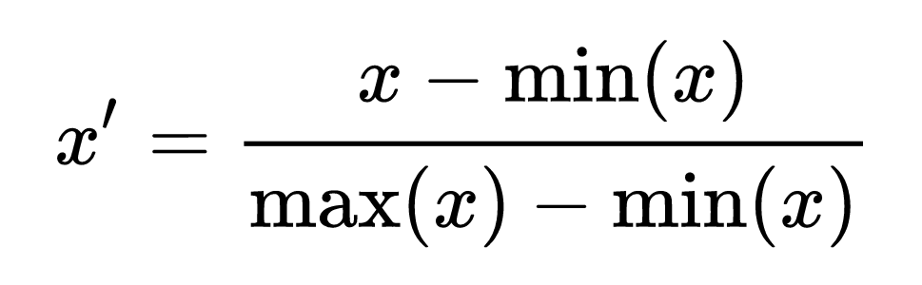
Linear Regression: Generate Training Data
To simulate real world data, we use np.random.uniform(low, high, size) to
add some noise to the idea data set. Thise noise is uniformly distributed
over the half-open interval [low, high), which is, -8 ~ 7.
Normalizing the data to a standard range such as 0 ~ 1 can facilitate
the learning process and improve the model’s performance.
The method we used here is called min-max feature scaling.

Slide 10
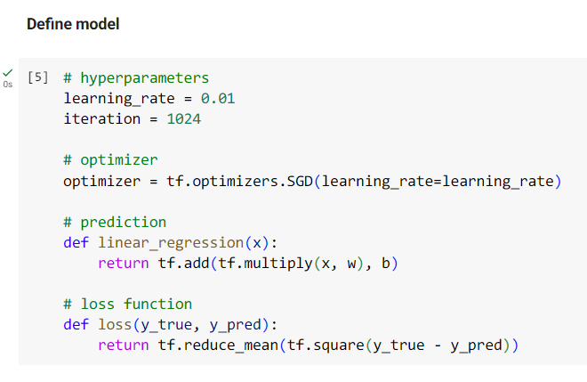
Linear Regression: Define Model
Stochastic Gradient Descent (SGD) optimizer is a type of gradient
descent that has the batch size equals to one.
Define function linear_regression() to calculate the y coordinate
(prediction) based on the formula y = wx + b.
Mean Square Error is implemented by utilizing tf.square() to get the
square of the each errors between prediction and target, then call
tf.reduce_mean() to compute the mean of the elements in the list.

Slide 11
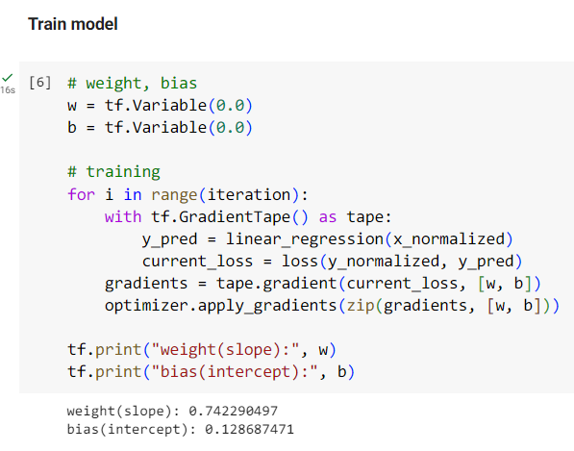
Linear Regression: Train Model
Now we create variables to store weight and bias and start the training.
In each iteration, the prediction is computed and passed into loss
function to calculate the loss value.
The gradient is computed by tf.GradientTape().gradient(target, source)
and will be passed into optimizer.apply_gradients(grads_vars) to update
the weight and bias, where grads_vars is a list of (gradient,variable).

Slide 12
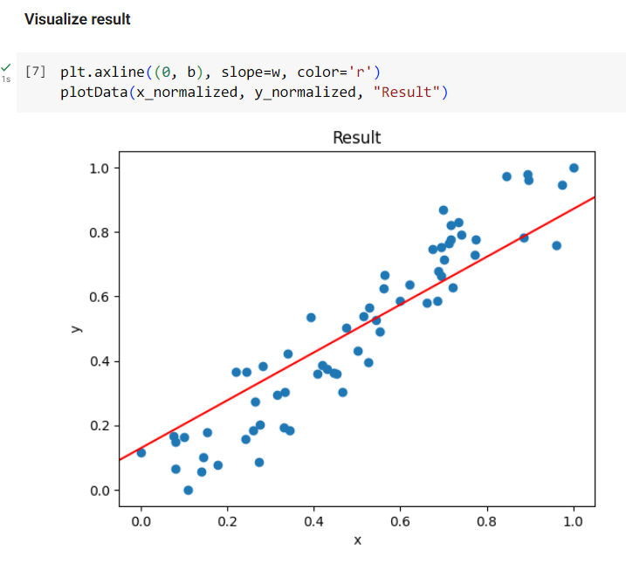
Linear Regression: Final Result
Finally, we use plt.axline() with the slop and intercept we got from the
model to draw the result. The first argument is the y-intercept and the
second argument is the line’s slope.
To distinguish the line from data points, we set the color of the line
using color=’r’.
As you can see, we made a good prediction that captures the tendency
of the training data. You can adjust the number of iterations to see how
it affect the prediction.

Slide 13

High-Level APIs
We can certainly design and implement ML models from scratch, but why reinvent the wheel
when we already have access to powerful and high-level APIs that we can utilize?
1. tf.estimator
Abstraction and Encapsulation of traditional ML algorithms
Was deprecated in TensorFlow 2.x
2. tf.keras (will be discussed in the next chapter)
Mainly for constructing and training Deep Neural Networks
3. Scikit-learn (the tool we are going to use)
Majorly used for traditional ML algorithm
Also provides useful tools for data analysis

Slide 14
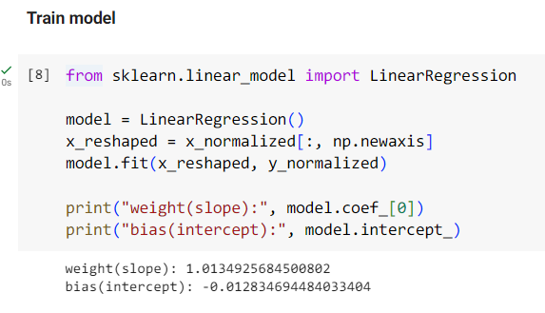
Linear Regression: Scikit-Learn Implementation
We import the Linear Regression class from sklearn package and use it to
create a model object.
The training data needs to be reshaped from [x1, x2, …, xn] to
[[x1], [x2], …, [xn]] because we have only one feature: the x coordinate for
each sample. This operation is done by updating x using x[: np.newaxis].
We then use model.fit() to train the model, and the slope and intercept will
be stored in model.coef_[0] and model.intercept_ afterward.
In fact, Scikit-Learn use Ordinary Least Squares (OLS) method to optimize the slope and intercept instead of Gradient Descent-like algorithms.

Slide 15
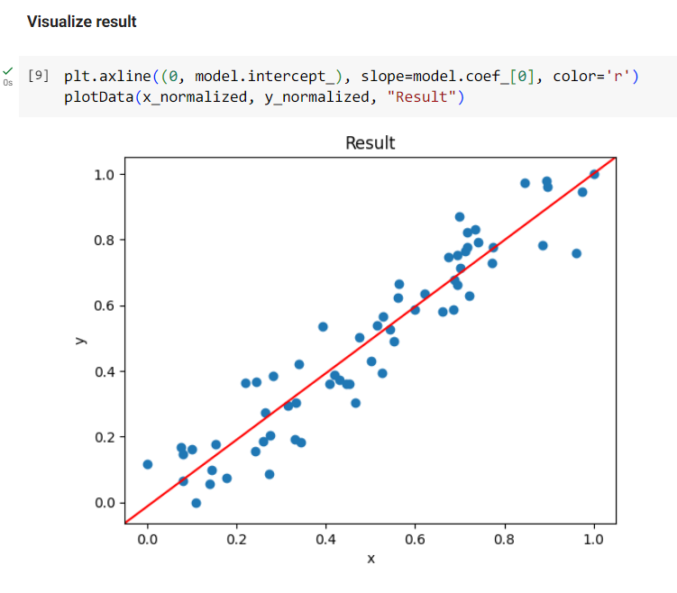
Linear Regression: Scikit-Learn Implementation
Draw the line using plt.axline(), and make a scatter plot using plotData().

Slide 16
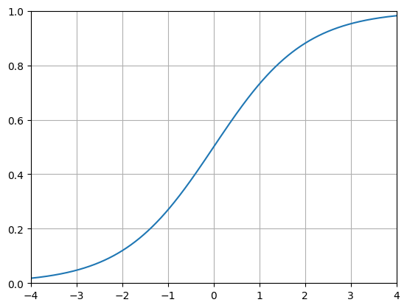
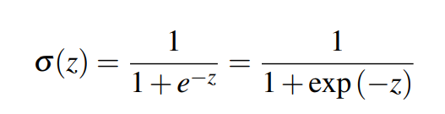
Logistic Regression
Logistic regression is designed for classification rather than regression. The idea is to
predict the probabilities between two classes, corresponding to 0 and 1 respectively.
Calculate the weighted sum of the input
Use an activation function: Sigmoid to predict their probabilities
A threshold to determine a prediction’s class
E.g. p >= 0.5: true, p < 0.5: false
Sigmoid function

Slide 17
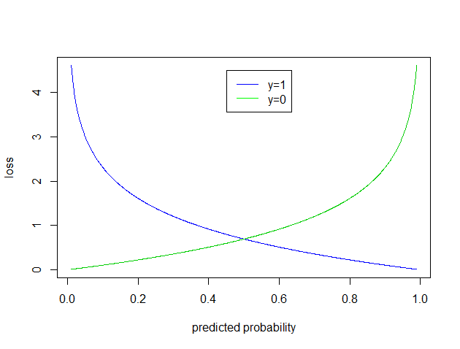
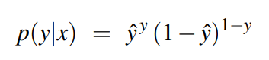
Logistic Regression: Loss Function
The loss function used here is called maximum likelihood estimation (MLE), or generally, a type of cross-entrophy loss.
In binary case, the probability for one observation is stated as follows:
After taking the log and flip the sign, we get a formal definition like this:
Cross entropy
The y-hat is the prediction, which can be replaced by the output of the sigmoid function:
https://web.stanford.edu/~jurafsky/slp3/5.pdf

Slide 18
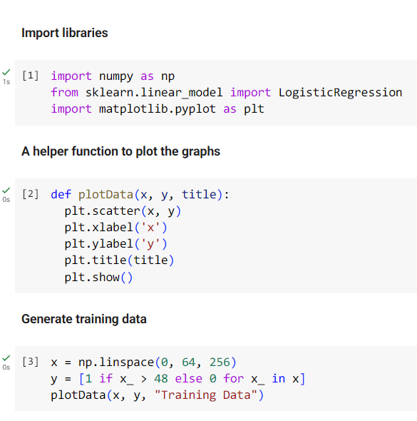
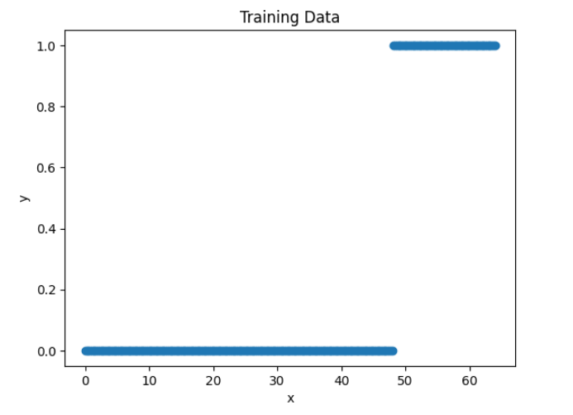
Logistic Regression: Training Data
This time, we import the LogisticRegression from sklearn.
The data set x is created using np.linspace(start, stop, num), which can be view as 256 people with weight ranges
from 0 to 64. The label y represents whether a person is over 48kg or not, and it is labeled as 1 and 0 otherwise.

Slide 19
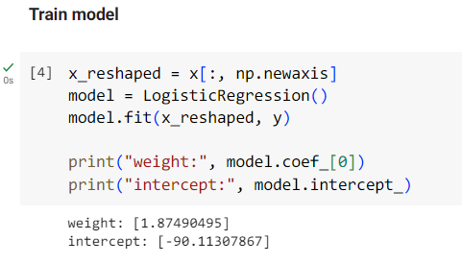
Logistic Regression: Training
We can train the model in a similar way, just like what we did
in linear regression implementation.
The default optimization solver algorithm is L-BFGS-B, the
other available optimizers can be found here

Slide 20
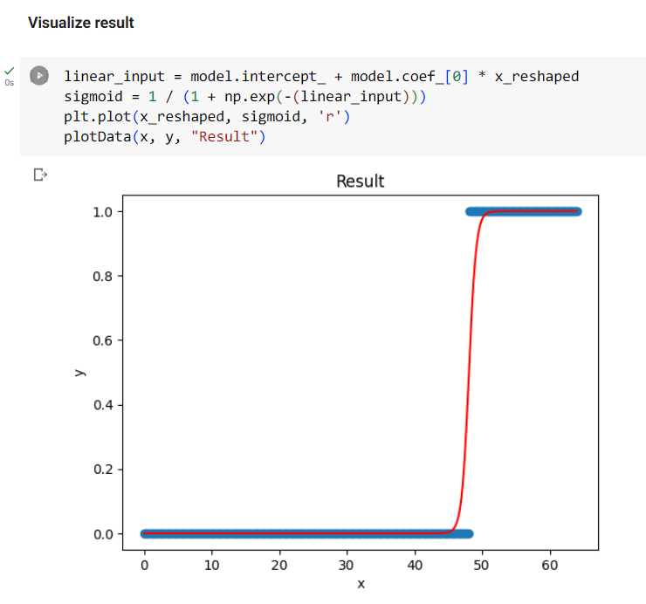
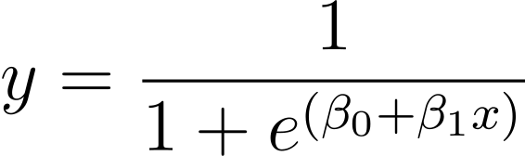
Logistic Regression: Result
The first line represents the equation: y = b0 + b1x, which is
later passed into the sigmoid function in the second line.
The default threshold is set to 0.5, it means that if the y
coordinate is predicted to have a value greater than 0.5, it is
then considered to be “true” or 1.

Slide 21

K-means Clustering: Procedure
As its name implies, K-means clustering is a clustering algorithm that partition samples into k clusters.
Step 1: Select the number of clusters, K.
Step 2: Select K centroids randomly.
Step 3: Assign the samples to their closest centroid to initialize K clusters.
Step 4: Calculate the Euclidean distances between samples and centroids.
Step 5: Reassign samples to the nearest centroids.
Step 5: Repeat Step 4 to Step 5 until the centroids converge.
https://en.m.wikipedia.org/wiki/File:K-means_convergence.gif

Slide 22
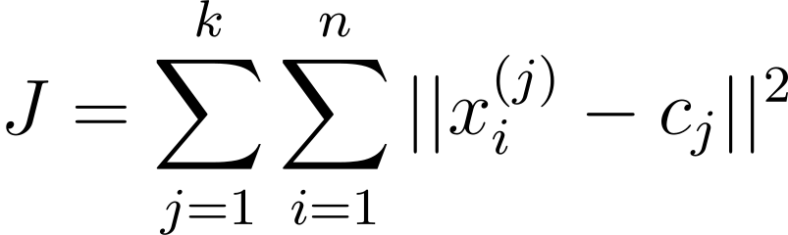
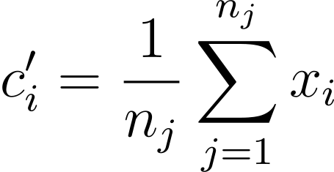
K-means Clustering: Loss Function
Since the goal is to minimize the Euclidean distances between data points and centroids,
the loss function can be defined as the sum of distances as the formula below:
xi: ith data point, cj: centroid of the jth cluster
And we take the average of data points in the jth cluster as the new centroid for each cluster:
ni: number of data points in the jth cluster

Slide 23
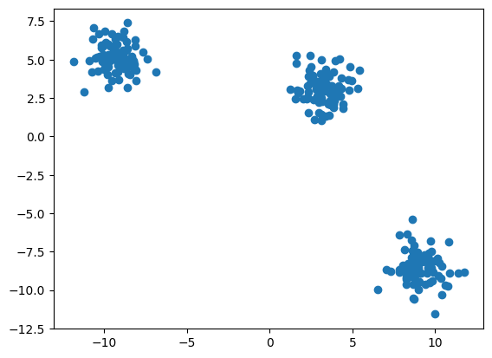
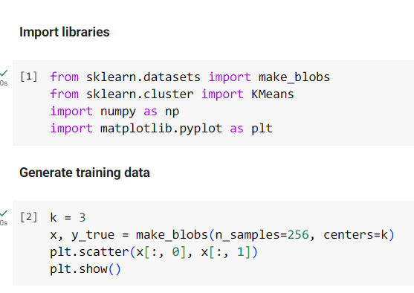
K-means Clustering: Training Data
We import the KMeans class from sklearn.cluster and the make_blobs() method from sklearn.dataset.
make_blobs(n_samples=256, centers=k) will create k blobs as the clusters with a total of 256 data
points, where each single data point will have two features by default: [[x1, x2], [y1, y2], …, [n1, n2]].

Slide 24
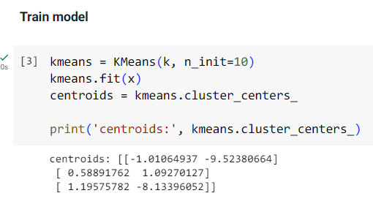
K-means Clustering: Training
Call Kmeans(n_clusters=k, n_init) method to create a K-means
clustering model with k centroids. The parameter n_init indicates the
number of times random initial centroids are genereated.
After the training is finished, the resulting centroids will be stored in
kmeans.cluster_centers_.
Each centroid has two features and can be used as x and y
coordinate for data visualization.

Slide 25
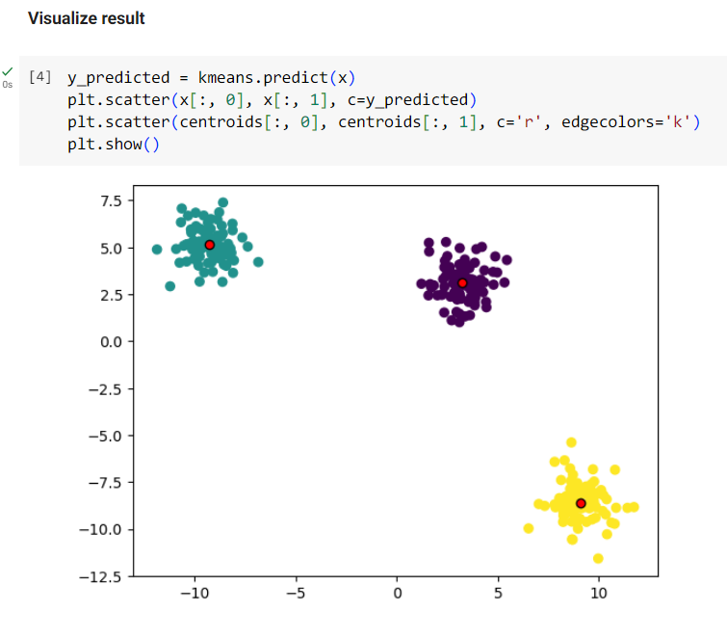
K-means Clustering: Result
We predict the cluster labels of each data points, and
assign different color to different groups of data points
based on their labels using plt.scatter(x, y, c=labels).
The slice x[:, 0] means “take the first element (at index 0)
in second dimension from each element in the first
dimension”, e,g, [[x1, [y1], …, [n1]]

